Slide 1
Basic Neural Network Models
Data: X
Task: y
Representation: : x, f() Score Function: L()
Search/Optimization : argmin()
Models, Parameters, metrics
X: Tabular / 2D / 1D / 3D / Graph /…
Classification / Regression Multilayer Network
topology
neg Log-likelihood , Cross- Entropy / MSE / Many more
SGD / Backprop
Weights and biases in NN Layers
/ Accuracy / F1
10/1/20
1

Slide 2


_{e}β₀ +β x
T
Review:Logistic Regression Classifier
P( y = 1 x) = _{T}
_{1+ e}β₀ +β x
Data: X
Task: y
Representation: : x, f() Score Function: L()
Search/Optimization : argmin()
Models, Parameters, metrics
X: Tabular
Binary Classification
Log-odds y = linear function of Xs MLE
Iterative (Newton) method
/ SGD
Logistic weights
/ Accuracy / F1
10/1/20
2

Slide 3
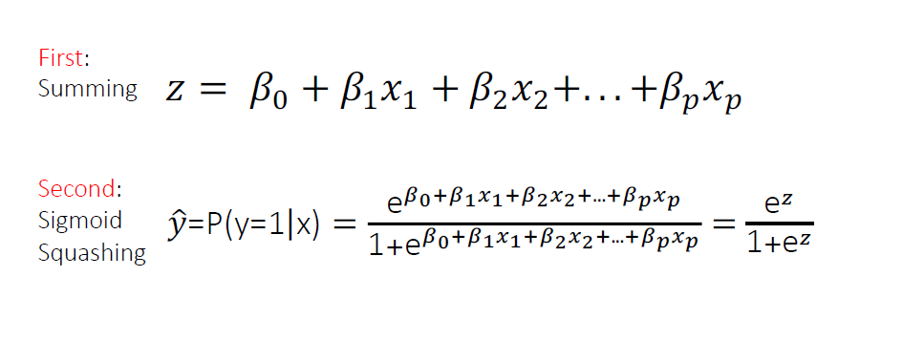
ReWrite Logistic Regression as two stages:
10/1/20
3

Slide 4

One “Neuron”: Expanded Logistic Regression
x₁
_{w}1
_{w}2
z
x₂
Σ
Summing Function
ŷ = P(Y=1|x,w)
Input x
p = 3
_{w}3
Sigmoid Function
x₃
_{b}1
Multiply by weights
+1
z = w^{T .} x + b
y = sigmoid(z) =
_{e}z
1 + e^{z}
7

Slide 5
E.g., Many Possible Nonlinearity Functions
(aka transfer or activation functions)
Name | Plot | Equation | Derivative ( w.r.t x )
usually works best in practice
8
https://en.wikipedia.org/wiki/Activation_function#Comparison_of_activation_functions

Slide 6

DNN Basics
Basics of Neural Network (NN)
single neuron, e.g. logistic regression unit
multilayer perceptron (MLP)
various loss function
E.g., when for multi-class classification, softmax layer
training NN with backprop algorithm
A few advanced tricks
10/1/20
6

Slide 7
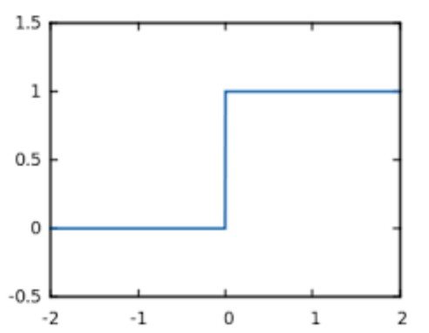
History Perceptron: 1-Neuron Unit with Step
−First proposed by Rosenblatt (1958)
−A simple neuron that is used to classify its input into one of two categories.
−A perceptron uses a step function
x₁
w₁
w₂
Σ
z
x₂
w₃
Step Function
x₃
b₁
Summing Function
⎧+1 if z ≥ 0
^{φ(z) = ⎨}−1 if z < 0
Multiply by weights
⎩
+1
10/1/20
9

Slide 8
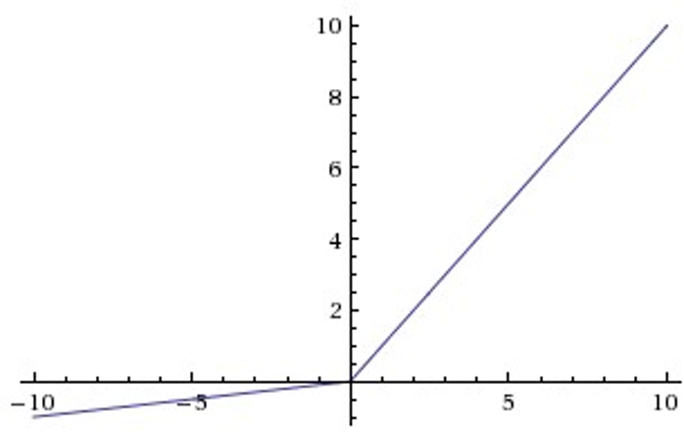
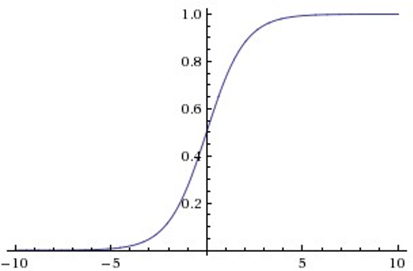
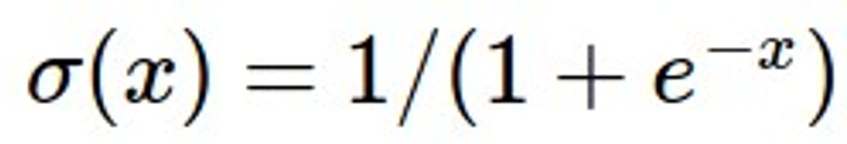
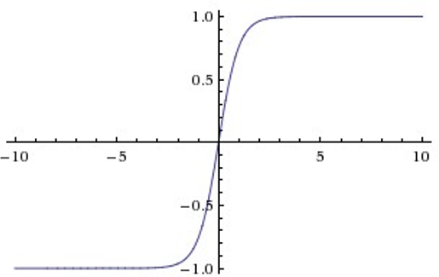
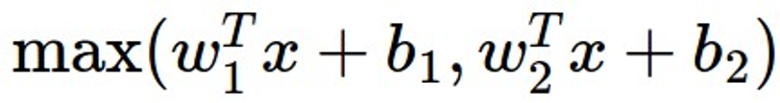
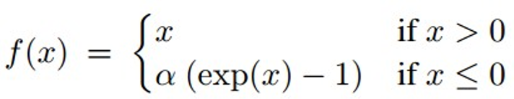
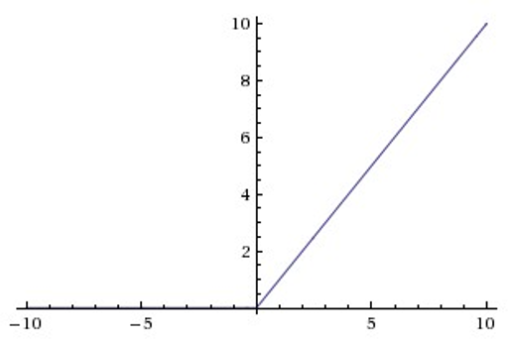
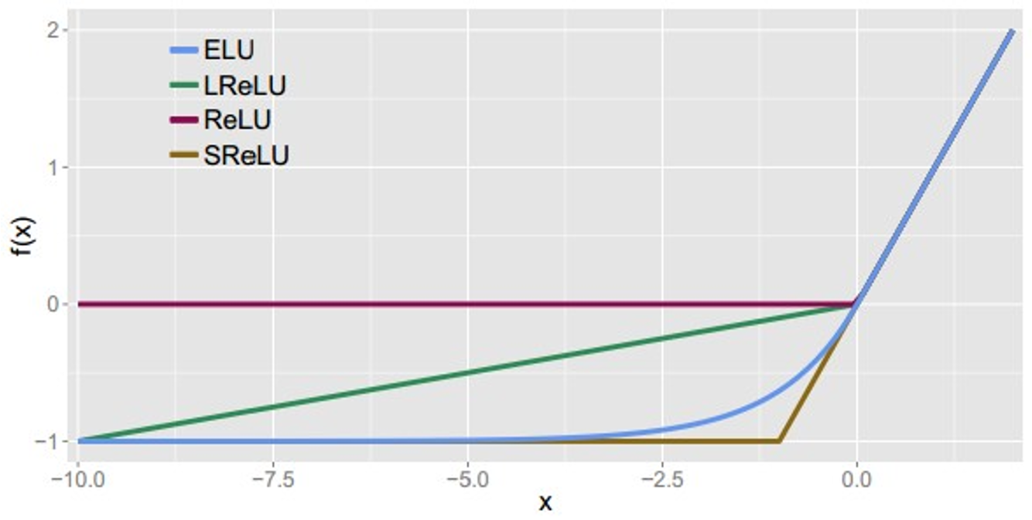
Leaky ReLU max(0.1x, x)
Sigmoid
Maxout
ELU
tanh
tanh(x)
ReLU
max(0,x)
10
From Feifei Li Stanford Cousre

Slide 9
Bias Term?
x₁
_{w}1
_{w}2
z
x₂
Σ
Summing Function
ŷ = P(Y=1|x,w)
Input x
p = 3
_{w}3
Sigmoid Function
x₃
_{b}1
Multiply by weights
+1
z = w^{T .} x + b
y = sigmoid(z) =
_{e}z
1 + e^{z}
11

Slide 10
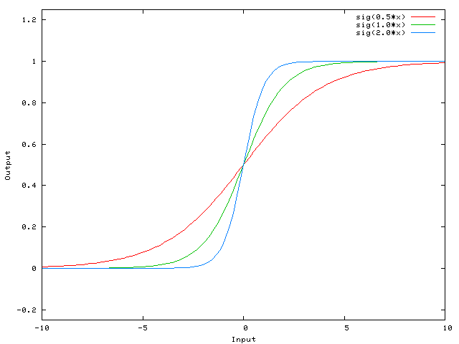
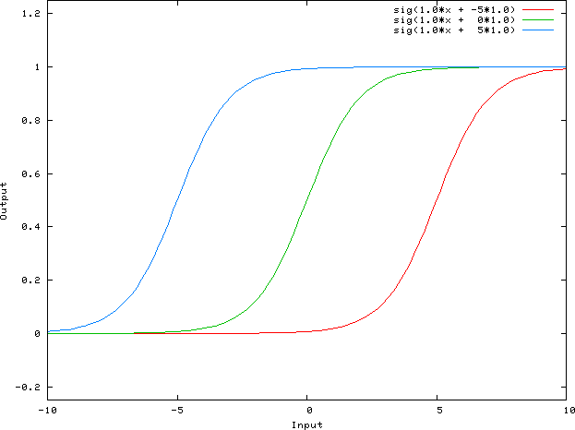
Without/ with Bias Term
x
Without Bias Term f(x)= ax ➔if x=0 same point
With Bias Term f(x)= ax +b ➔# points
12

Slide 11

Roadmap: DNN Basics
Basics of Neural Network (NN)
single neuron, e.g. logistic regression unit
multilayer perceptron (MLP)
various loss function
E.g., when for multi-class classification, softmax layer
training NN with backprop algorithm
10/1/20
14

Slide 12

Neuron Representation
x₁
w₁
w₂ w₃
x
x₂
ŷ
Σ
x₃
From here on, we leave out bias square for simple visualization
The linear transformation and nonlinearity together is typically considered a single neuron
12

Slide 13

Multi-Layer Perceptron (MLP)- (Feed-Forward NN)
h1 h2
W₂
W₁
x1
w₃
x
ŷ
x2
x3
₁st
hidden layer
₂nd
hidden layer
Output Layer
for Binary Classification
13

Slide 14
Multi-Layer Perceptron (MLP)- (Feed-Forward NN)
h1 h2
W₂
W₁
x1
w₃
x
ŷ
x2
x3
₁st
hidden layer
₂nd
hidden layer
Output Layer
for Binary Classification
z =W^{T} x
1
1
hidden layer 1 output
h₁ = sigmoid(z₁)
z₂ =W^{T} h₁
2
hidden layer 2 output
h₂ = sigmoid(z₂)
z =w^{T} h
3 2
3
ŷ = sigmoid(z₃)
14

Slide 15
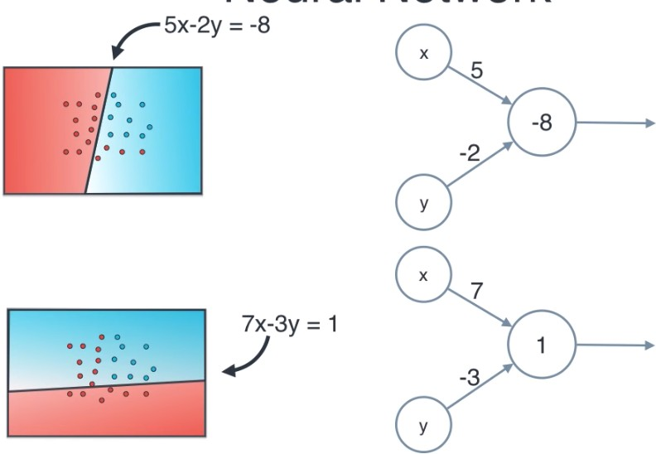
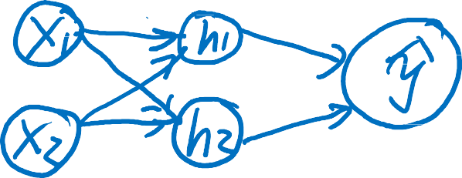





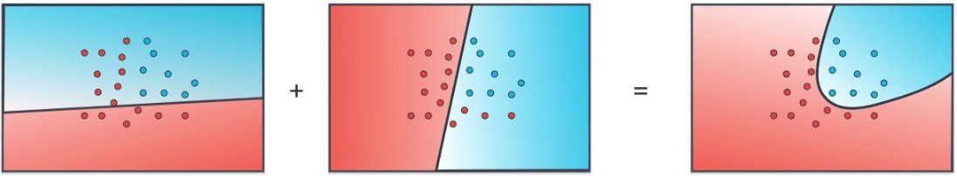
Bias
One neuron
Another neuron
How to combine to get nonlinear decision boundary?
10/1/20
20
A friendly introduction to Deep Learning and Neural Networks from Luis Serrano

Slide 16
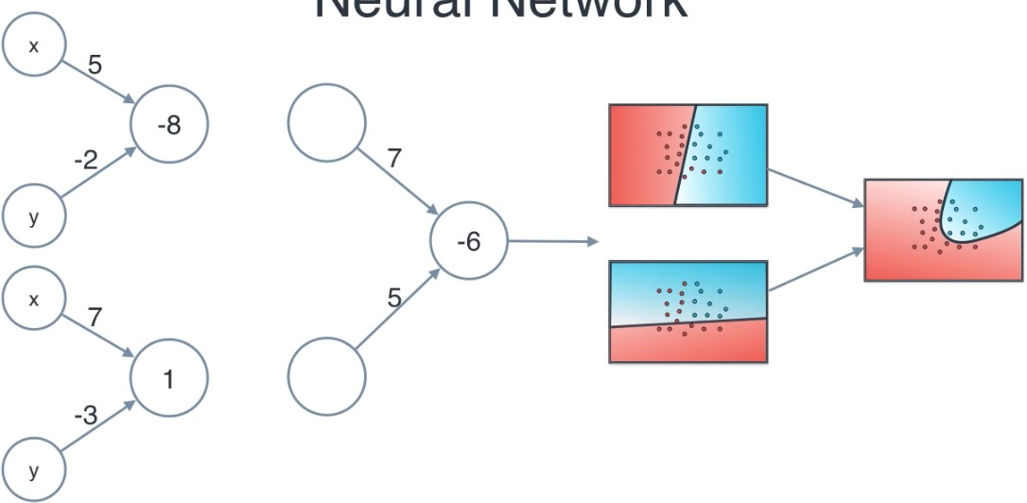


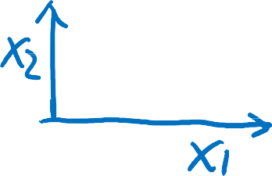

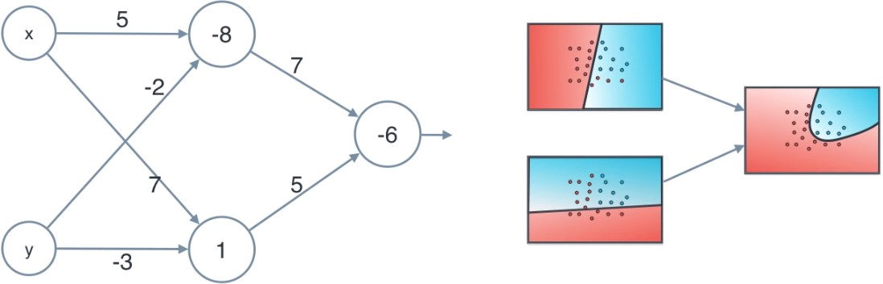









10/1/20

Slide 17
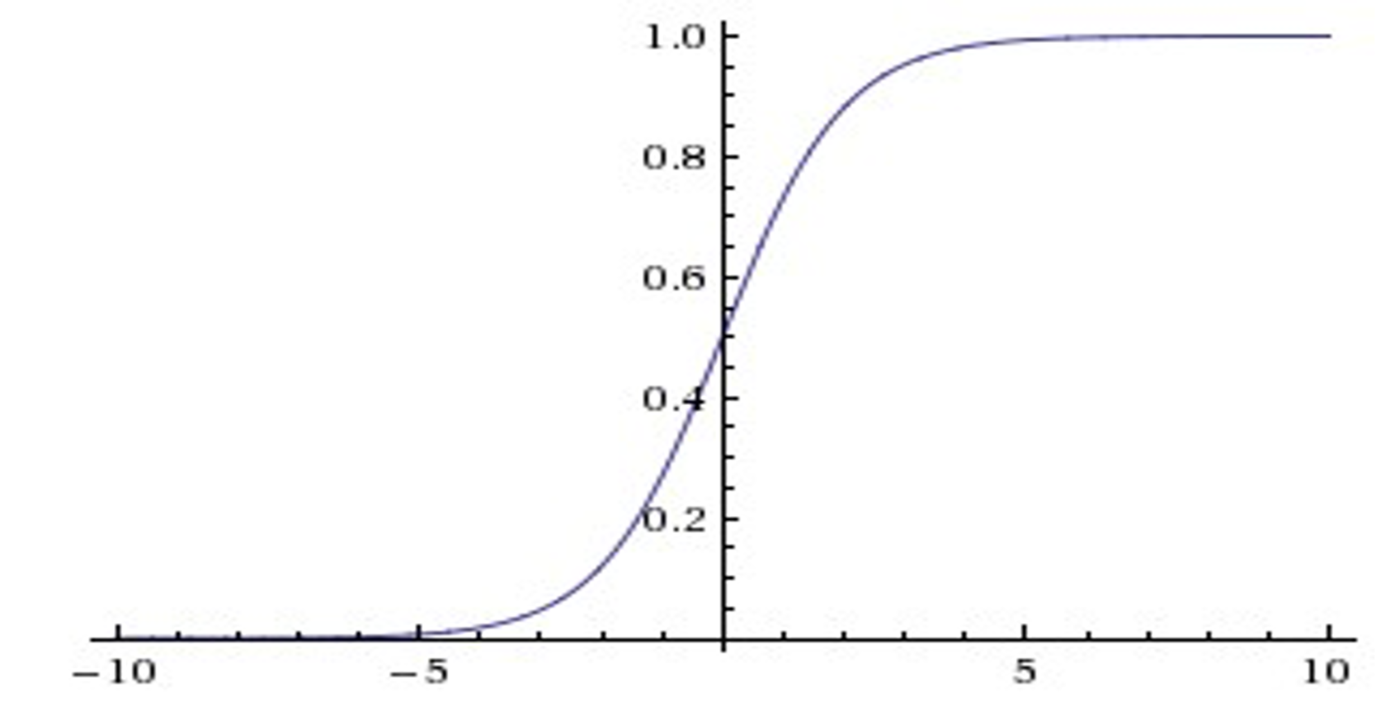
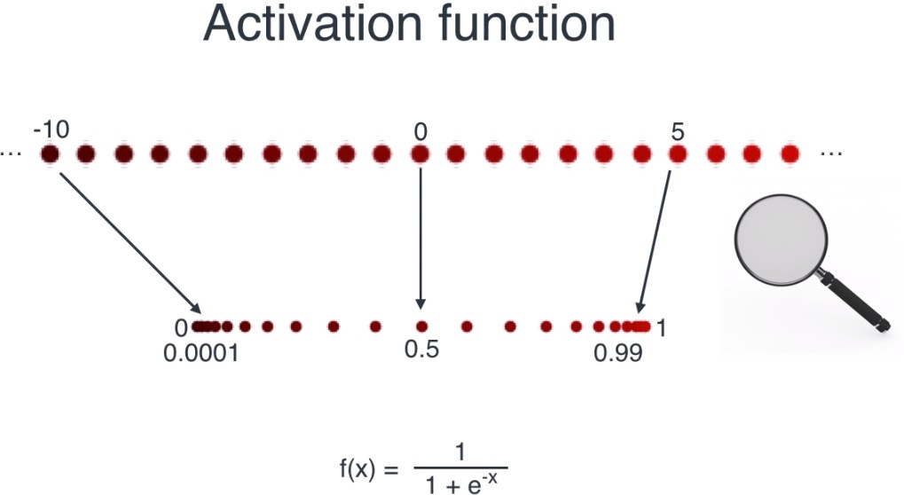











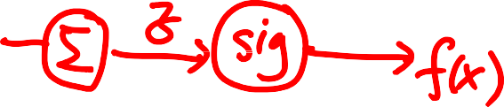




From https://www.youtube.com/watch?v=BR9h47Jtqyw&list=PLs8w1Cdi-zvavXlPXEAsWIh4Cgh83pZPO&index=3
10/1/20

Slide 18
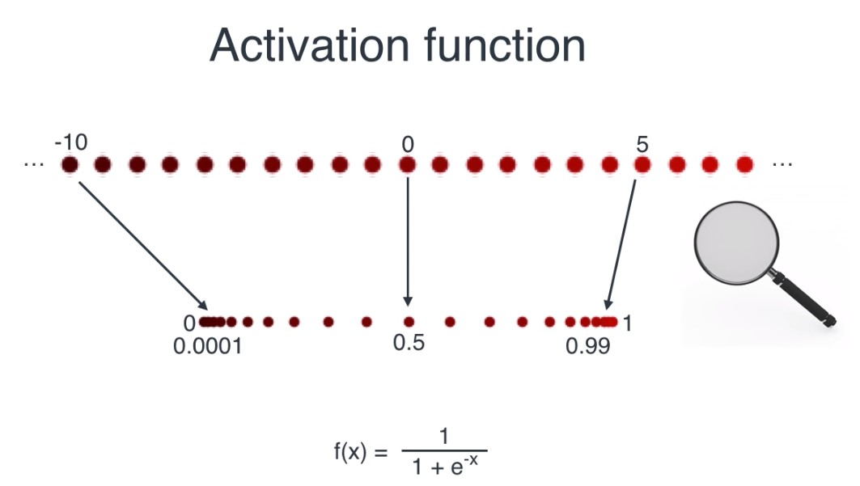
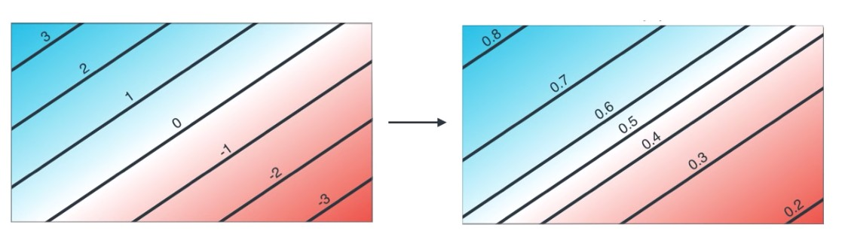
From https://www.youtube.com/watch?v=BR9h47Jtqyw&list=PLs8w1Cdi-zvavXlPXEAsWIh4Cgh83pZPO&index=3
10/1/20

Slide 19
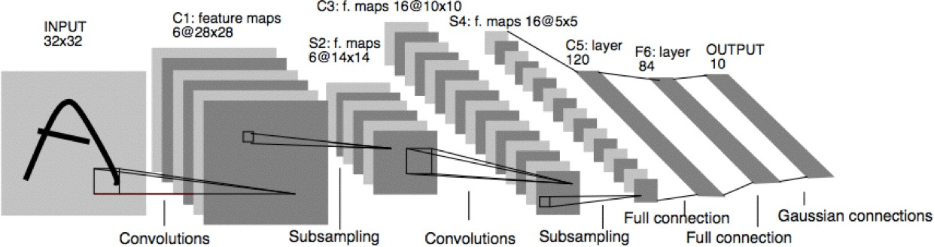
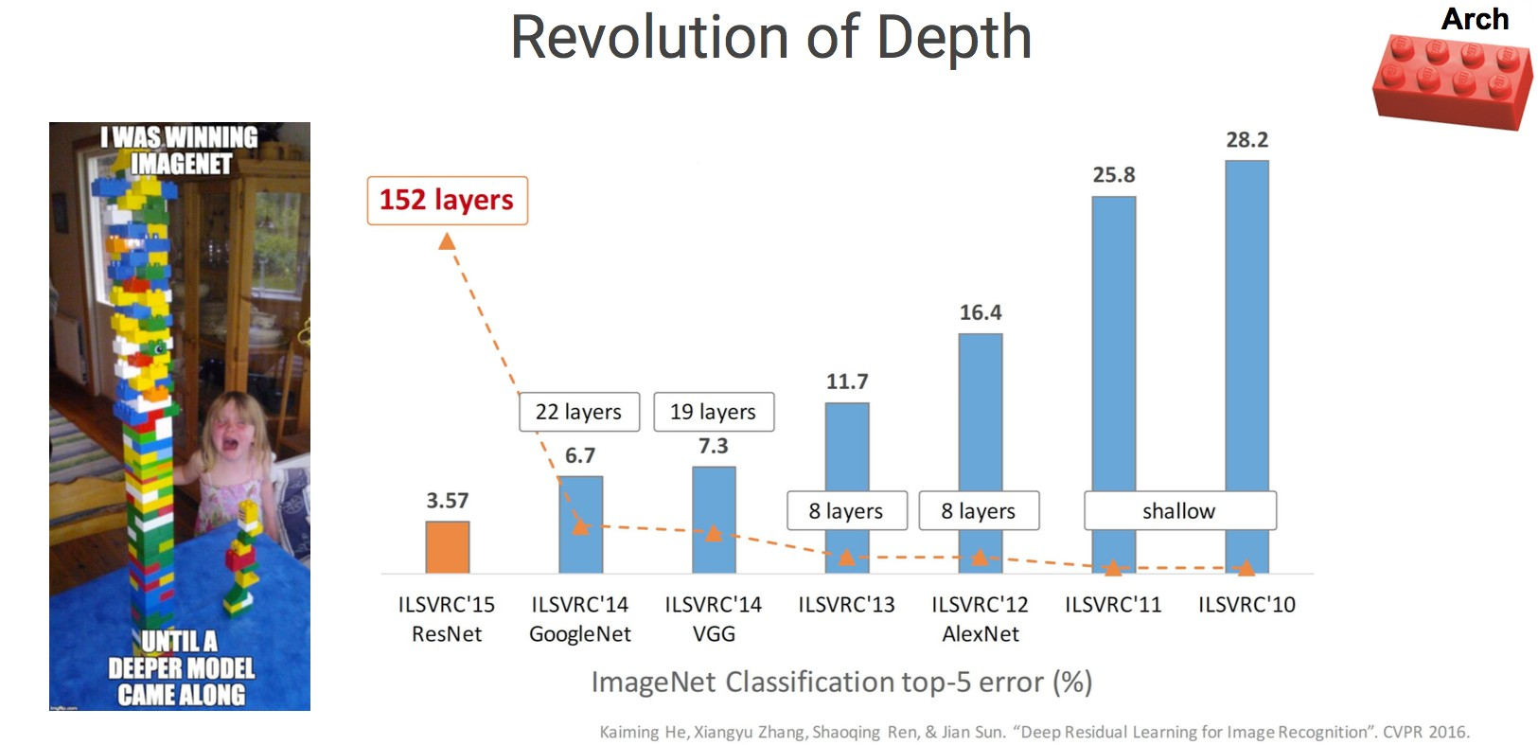

“Deep” Neural Networks (i.e. many hidden layers)
19

Slide 20



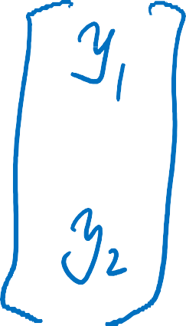

E.g., SSE loss on Multi-Layer Perceptron (MLP) for Regression
Example: 2 Hidden Layer MLP network with 2 output units:
x₁
ŷ₁ ŷ₂
x₂
x₃
+1
output
+1
+1
input
hidden
hidden
EW (ŷ,y) = SSE = (y₁-ŷ₁)²+(y₂-ŷ₂)²
10/1/20

Slide 21


e.g., Cross-Entropy loss for Multi-Layer Perceptron (MLP) for Binary Classification
x₁
output
x₂
ŷ = P (Y=1|X,Θ)
x₃
E_{x} (θ ) = Loss_{x} (θ ) = −logPr(Y = y | X = x )
= −{ y_{i} log( yˆ _{i} )+(1− y_{i} )log(1− yˆ _{i} )}
+1
+1
input
hidden
Cross-entropy loss function, OR named as “deviance”, OR negative log-likelihood
10/1/20

Slide 22
e.g., Cross-Entropy loss for Multi-Layer Perceptron (MLP) for Binary Classification
x₁
For Bernoulli distribution,
p(y = 1 | x)^{y} (1− p)^{1−y}
output
x
2
ŷ = P (Y=1|X,Θ)
x₃
E_{x} (θ ) = Loss_{x} (θ ) = −logPr(Y = y | X = x )
= −{ y_{i} log( yˆ _{i} )+(1− y_{i} )log(1− yˆ _{i} )}
+1
+1
input
hidden
Cross-entropy loss function, OR named as “deviance”, OR negative log-likelihood
10/1/20

Slide 23








Binary Classification Multi-Class Classification
models the target binary random variable with Bernoulli whose parameter p=p(y=1|x) predefined as function on x
1-p(y=1x)
Multinoulli Distribution, e.g.,
P(y=1|x)
_{e}z
1 + e^{z}
We need to estimate all p(y=1|x). P(y=2|x)….
Binary when we estimate one we can find the other (1-p)

Slide 24
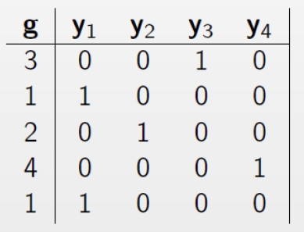
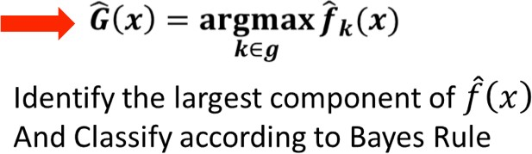
One hot encoding of Multi-Class Classification
Multi-class target variable representation
K=4
Total Class
Multi-class output variable
An indicator basis vector representation
If output variable G has K classes, there will be K indicator variable y_i (P(y=k|x)
How to classify to multi-class ?
First: learn K different regression
Then: Softmax using all K outputs as input
(CONVERTING K INTO PROBABILITY)
➔MAP(Find the largest probability )
10/1/20
(generalization of logistic regression

Slide 25




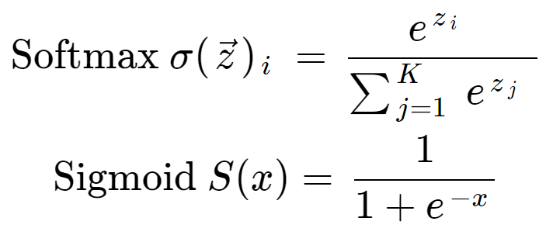
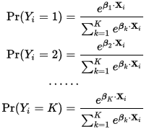
The softmax function is a function that turns a vector of K real values into a vector of K real values that sum to 1
Strategy : Use “softmax” layer function for multi-class classification
y₁
y
y₃
2
e
z_{i}
“Softmax” functio: Normalizing function which converts each class output to a probability.
z₁ z₂ z₃
Softmax Output
∑e
j
y_{i} =
z
j
∂y_{i}
= y_{i} (1 − y_{i} )
∂z_{i}
10/1/20

Slide 26
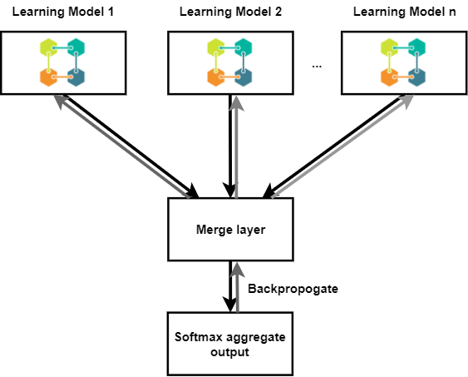
y₁
y
y₃
Output units
2
When for multi-class classification (last output layer: softmax layer)
z₁ z₂
z₃
last layer is softmax output layer ➔
a Multinoulli logistic regression unit
10/1/20

Slide 27
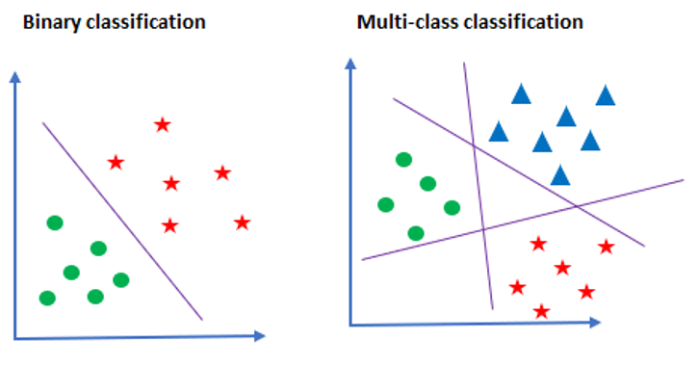
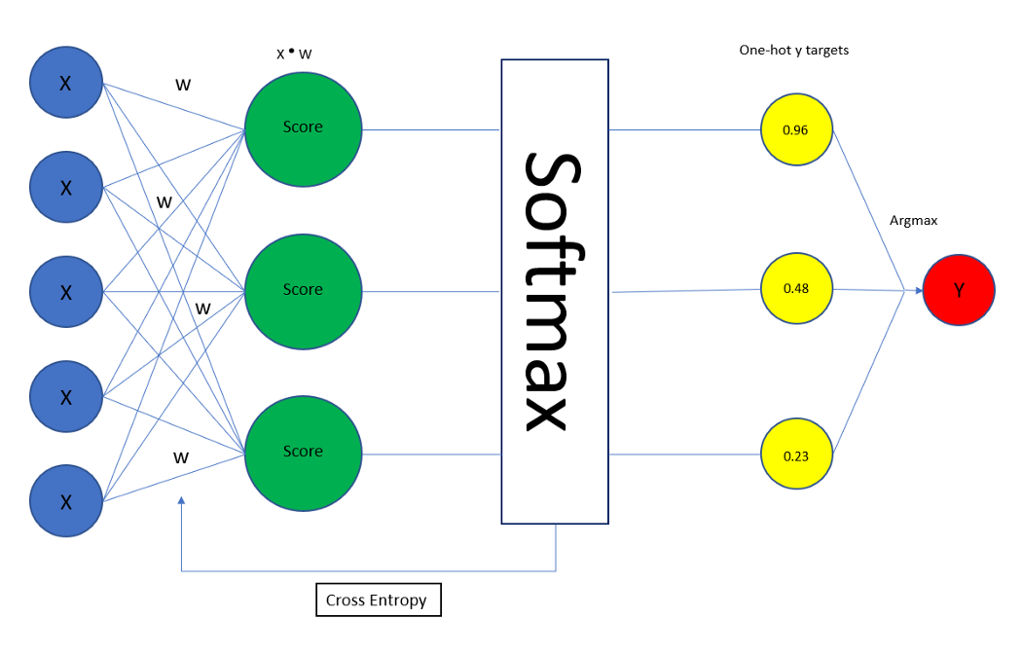
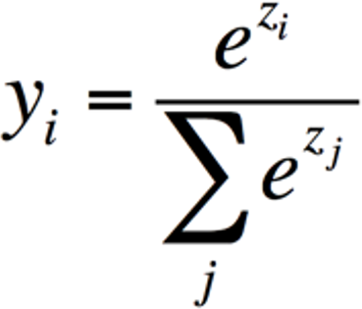






When for multi-class classification (last output layer: softmax layer)
last layer is softmax output layer ➔
a Multinoulli logistic regression unit
ŷ_{i}
= P( ŷ_{i} = 1 | x )
E_{W} (ŷ,y) = cross-E = - _{Σ} y_{j} ln ŷ_{j}
0
1
0
^{y}true
0.1
0.7
0.2
j = 1...K
MLE / the negative log probability of the right
answer / Cross entropy loss function :
= ln ŷ_{true}
ŷ
“0” for all except true class

Slide 28

Summary Recap: Multi-Class Classification Loss
Cross Entropy Loss
W₂
W
W₃
1
z₁
x₁
Σ
ŷ₁
z₂
ŷ_{i}
x
x₂
Σ
ŷ₂
= P( y_{i} = 1 | x )
x₃
z₃
ŷ₃
K = 3
Σ
“Softmax” function. Normalizing function which converts each class output to a probability.
0
1
0
y
0.1
0.7
0.2
ŷ
E = loss = -
Σ
y_{j} log ŷ_{j}
j = 1...K
“0” for all except true class
43

Slide 29
Conclusion: Logistic: a special case of softmax for two classes
_{e}z₁
1
y₁ = =
_{e} 1
−( z₁−z₀ )
z z
+ e ⁰ 1+ e
So the logistic binary case is just a special case that avoids using redundant parameters:
Adding the same constant to both z1 and z0 has no effect.
The over-parameterization of the softmax is because the probabilities must add to 1.
10/1/20

Slide 30
e.g., “Block View” of Logistic Regression
Training NN with backprop algorithm
W is a vector
z is a vector
W
z
output ŷ
E (ŷ,y)
loss
x
Input
*
Dot Product
Sigmoid
parameterized block, W needs to be learned
No Parameters to Learn
30

Slide 31


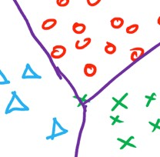
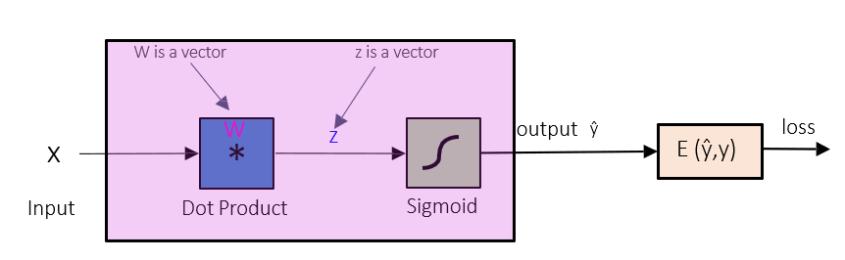
e.g., “Block View” of multi-class NN
W is a matrix
z is a vector
W1
z
h₁
W2
z
h₂
W3 _{z} “Softmax”
x
*
1
*
2
*
3
ŷ
E (ŷ,y)
₁st hidden layer
₂nd hidden layer
Output layer
Loss Module
“Block View” of Logistic Regression

Slide 32






W₁
W₂
x₁
w₃
x
x₂
ŷ
E (ŷ,y)
x₃
32

Slide 33
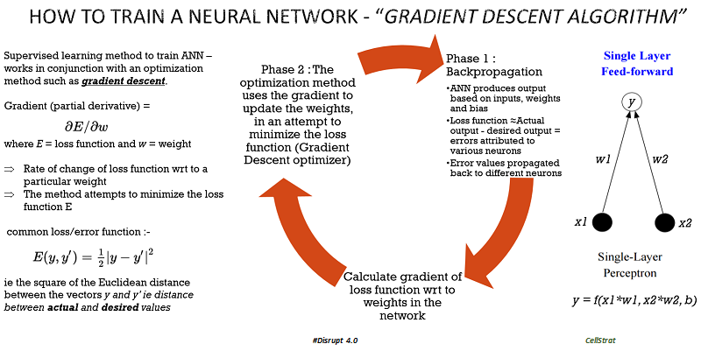
W^{t +1} = W^{t} − η ^{∂ E} = W^{t} + Δw
∂W^{t}
delta rule

Slide 34
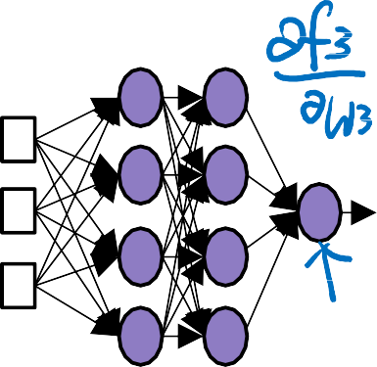
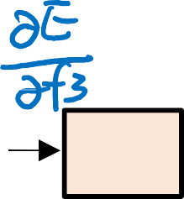











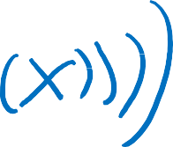

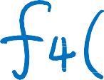












Training Neural Networks by Backpropagation - to jointly optimize all parameters
How do we learn the optimal weights W_{L} for our task??
Stochastic Gradient descent:
W₂
W^{t +1} = W^{t} − η ^{∂ Ex}
W₁
_{W}t
w₃
L L
x
L
ŷ
E (ŷ,y)
But how do we get gradients of lower layers?
Backpropagation!
Repeated application of chain rule of calculus
Locally minimize the objective
Requires all “blocks” of the network to be differentiable
54
LeCun et. al. Efficient Backpropagation. 1998

Slide 35
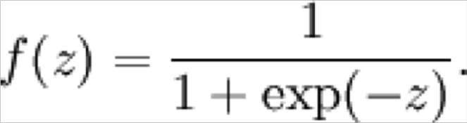
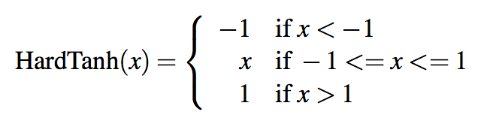
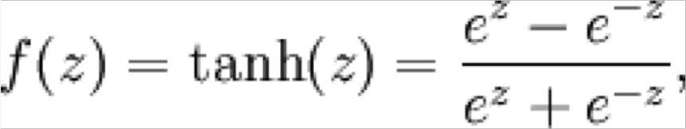
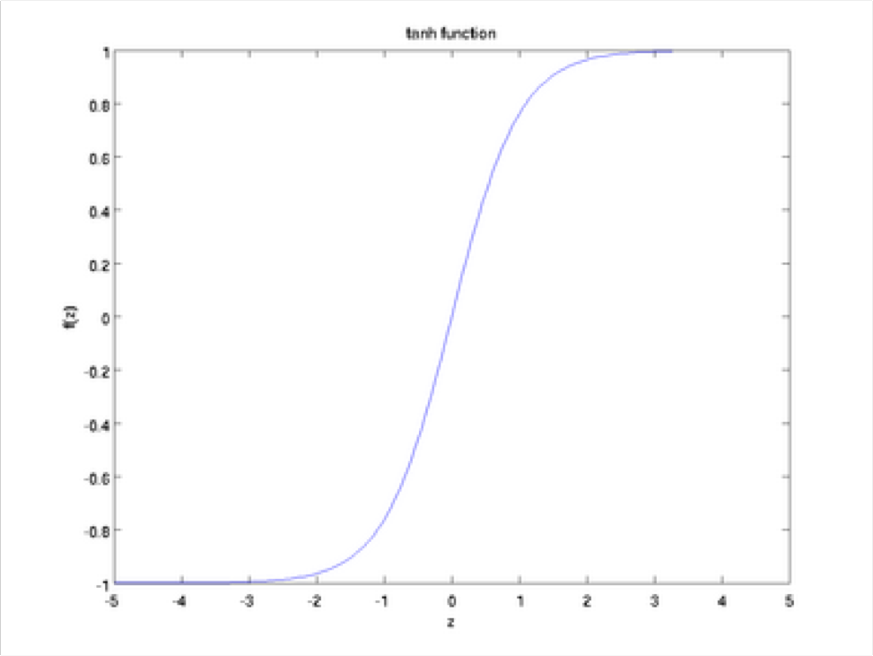
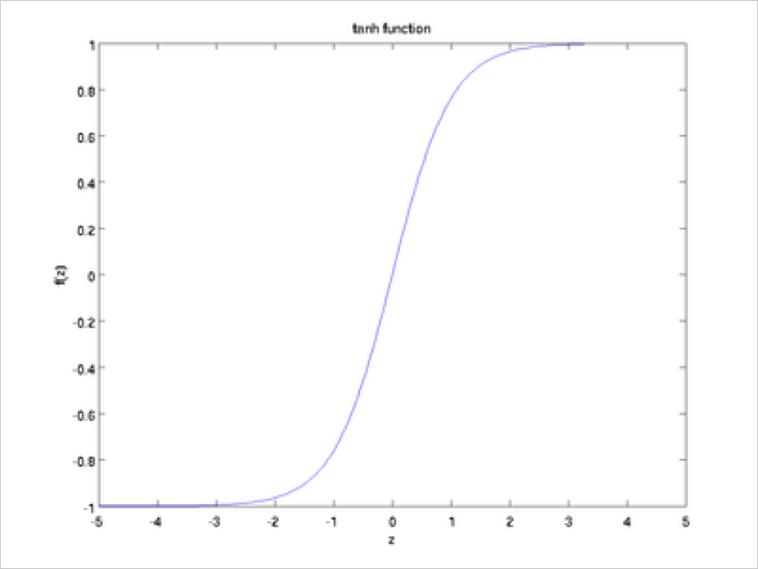
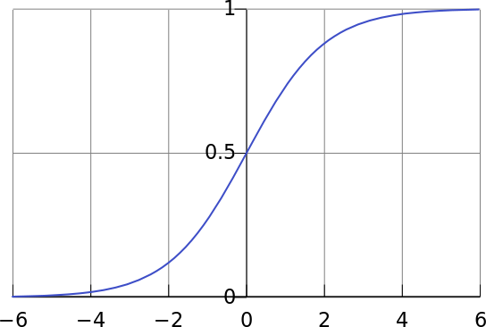



Non-linearities: The starting points
logistic (“sigmoid”) tanh hard tanh
1
1
0
−1
tanh is just a rescaled and shifted sigmoid (2 x as steep, [−1,1]):
tanh(z) = 2logistic(2z) −1
Both logistic and tanh are still used in particular uses, but are no longer the defaults for making deep networks

Slide 36
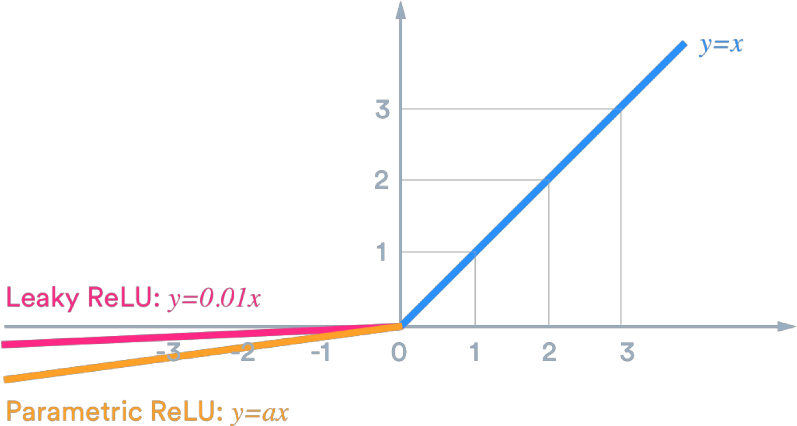
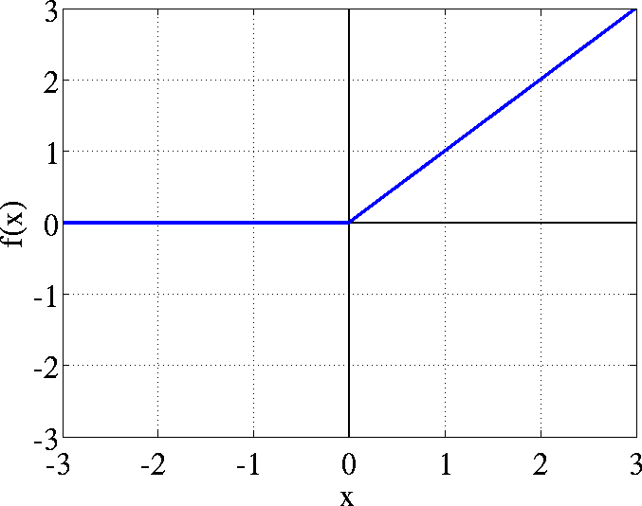
Non-linearities: The new world order
ReLU (rectified
linear unit) hard tanh
rect(z) = max(z, 0)
Leaky ReLU Parametric ReLU
For building a feed-forward deep network, the first thing you should try is ReLU — it trains quickly and performs well due to good gradient backflow

Slide 37
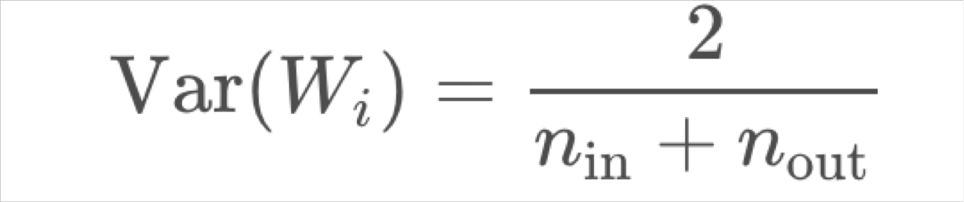
Parameter Initialization
You normally must initialize weights to small random values
To avoid symmetries that prevent learning/specialization
Initialize hidden layer biases to 0 and output (or reconstruction) biases to optimal value if weights were 0 (e.g., mean target or inverse sigmoid of mean target)
Initialize all other weights ~ Uniform(–r, r), with r chosen so numbers get neither too big or too small
Xavier initialization has variance inversely proportional to fan-in
n_{in} (previous layer size) and fan-out n_{out} (next layer size):

Slide 38
Optimizers
Usually, plain SGD will work just fine
However, getting good results will often require hand-tuning the learning rate (next slide)
For more complex nets and situations, or just to avoid worry, you often do better with one of a family of more sophisticated “adaptive” optimizers that scale the parameter adjustment by an accumulated gradient.
These models give per-parameter learning rates
Adagrad
RMSprop
Adam  A fairly good, safe place to begin in many cases
SparseAdam
…

Slide 39

Learning Rates
You can just use a constant learning rate. Start around lr = 0.001?
It must be order of magnitude right – try powers of 10
Too big: model may diverge or not converge
Too small: your model may not have trained by the deadline
Better results can generally be obtained by allowing learning rates to decrease as you train
By hand: halve the learning rate every k epochs
An epoch = a pass through the data (shuffled or sampled)
By a formula: !" = !"$%^{&'(}, for epoch t
There are fancier methods like cyclic learning rates (q.v.)
Fancier optimizers still use a learning rate but it may be an initial rate that the optimizer shrinks – so may be able to start high

